Slide 1
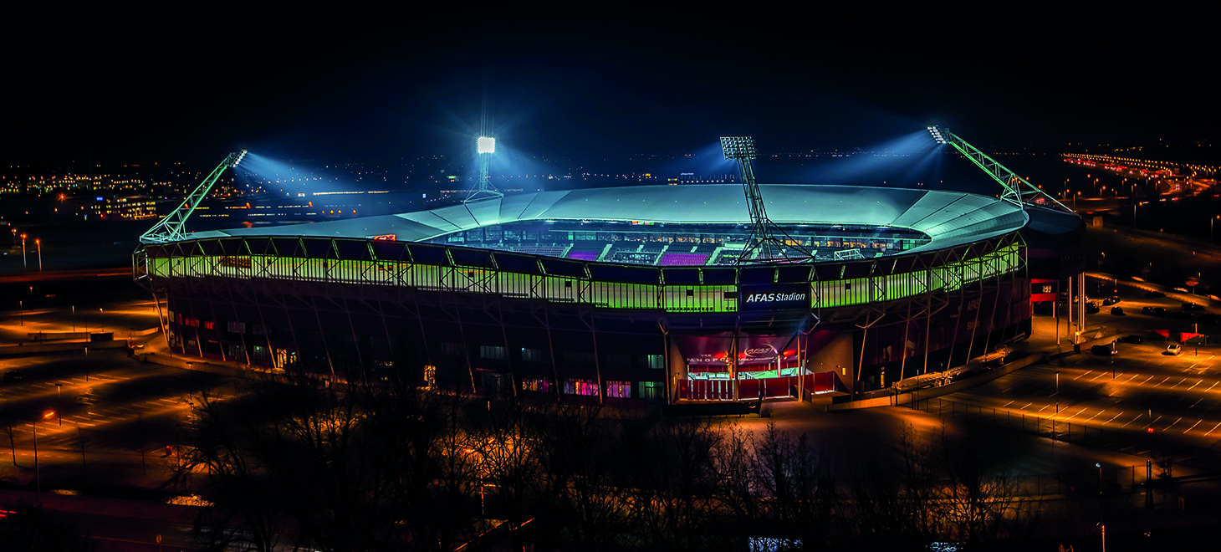

Supervisor Meeting
Mar 14, 2023

Slide 2
Objectives set at the last Supervisor Meeting
Objective 1: Display the jersey numbers in the animation
Objective 2: Build a pipeline for automatically classifying formations based on the players’ spatial arrangement
Objective 3: Try to create an initial prototype
Objective 4: Visualize the results of the clustering
Objective 5: Visualize the player velocities with arrows

Slide 3


What has been achieved?
Objective 1: Display the jersey numbers in the animation
Objective 2: Build a pipeline for automatically classifying formations based on the players’ spatial arrangement
Objective 3: Try to create an initial prototype
Objective 4: Visualize the results of the clustering
Objective 5: Visualize the player velocities with arrows

Slide 4

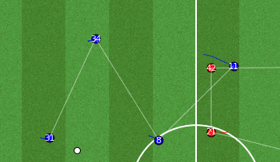
K-Means Clustering Visualized
Important Considerations:
The goalkeepers are not considered part of the formation lines
Formation lines are updated every 5 frames (good tradeoff between computational resources and functionality)
The clustering is performed vertically

Slide 5
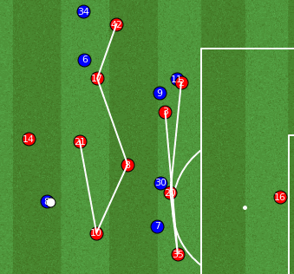
Future Work
Next steps:
make the lines “stick” to the players
connect players based on their y-coordinates
line-breaking passes

Slide 6
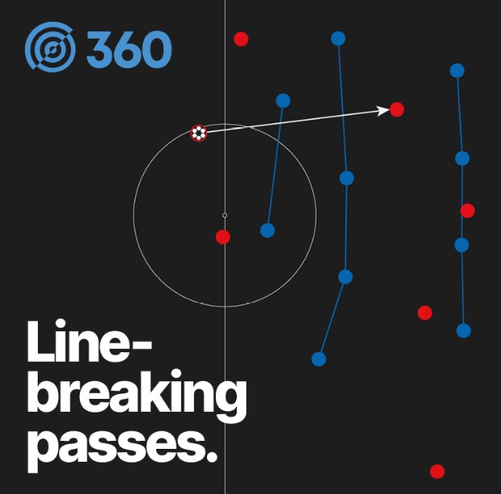
A Look Into The Future: Line-Breaking Passes
What is a line-breaking pass?
completed passes that advance the ball at least 10% closer to the opposition goal and that intersect a pair of defenders in close proximity (x-axis) or pass behind the defensive line (y-axis)

